Slide 1
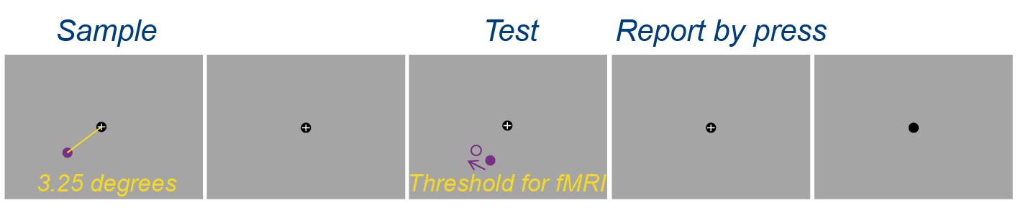
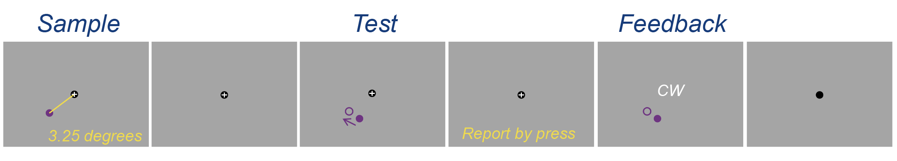
Experimental design
Response
Test:
1 trial = 15.5 s
1 run = 42 trials ～= 11 min
3 test ~= 33 min
Test
0.5 s
12 s
0.5 s
max 1.5 s
1 s
Training:
1 trial = 9 s
1 run = 42 trials ～= 6.3 min
10 run ~= 1h
3 days
Correct
Training
Wrong with beep
0.5 s
4 s
0.5 s
max 1.5 s
1 s
1 s
Training
( with feedback)
Pre-test
Post-test
Training:
Staircase – 3 up 1 down
Stop-rules – 42 trials

Slide 2
Hypothesis
After training, the participants’ discrimination threshold is reduced.

